Slide 1

Project Proposal
Data Analysis Project Proposal for SQL for Data Science Capstone Project
August 2021
Ken Peters

Slide 2
Olympics Dataset - 120 years of Data
Client:
SportsStats is a sports analysis firm partnering with local news and elite personal trainers to provide “interesting” insights to help their partners. Insights could be patterns/trends highlighting certain groups/events/countries, etc. for the purpose of developing a news story or discovering key health insights.

Slide 3
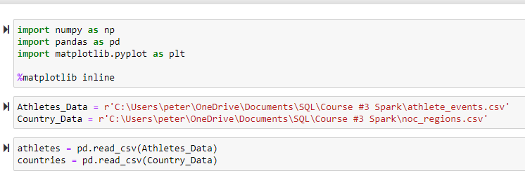
Import Data

Slide 4
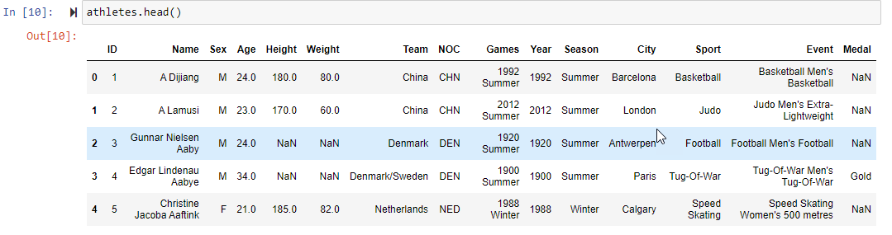
Explore Data

Slide 5
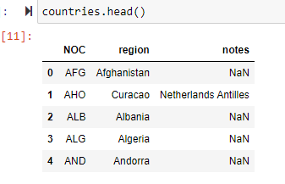
Explore Data (Continued)

Slide 6
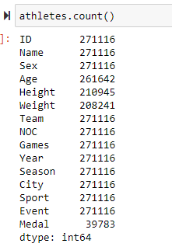
Explore Data (Continued)
All the Features have the same number of values except Medal. When an athlete does not win a medal, the table has “NaN”. This is okay because that will be treated as “0” in counts.

Slide 7
QUESTIONS TO ANSWER
Q1
What are the trends of the number of Women Competing.
Q2
Who are the Top Athletes.
Q3
Since I am from the USA, how is the total number of medals won by the USA changing.
-Obviously likely increasing because participation and the number of events are increasing. But, let’s examine this.

Slide 8
Initial Hypotheses
Q1-The percent of women competing is usually increasing
Q2-Which athletes have won the most medals?
Q3-The numbers of medals won by USA athletes is consistently increasing. Does this fit a Linear Regression model.

Slide 9
Data Analysis Approach
Features (Columns/Fields)
Sex
Medals
Region = USA
Relationships to explore
Male vs. Female
Total medal count per athlete
Total medal count per year for the USA
Metric Evaluation measure
Percent
Sum
Linear Regression

Slide 10
Initial exploration of data
Features (Columns/Fields)
Sex
Medals
Region = USA
Relationships to explore
Male vs. Female
Total medal count per athlete
Total medal count per year for the USA
Metric Evaluation measure
Percent
Sum
Linear Regression

Slide 11
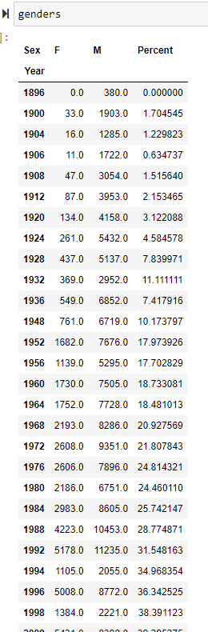
Initial exploration of data

Slide 12
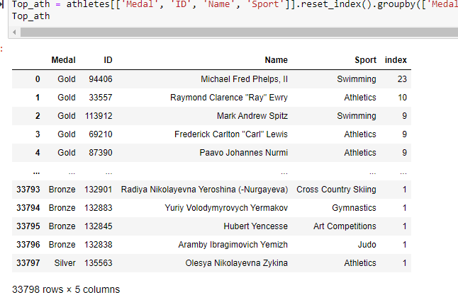
Initial exploration of data

Slide 13
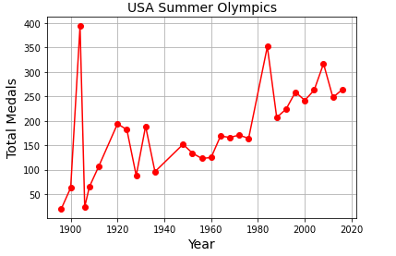
Initial exploration of data

Slide 14
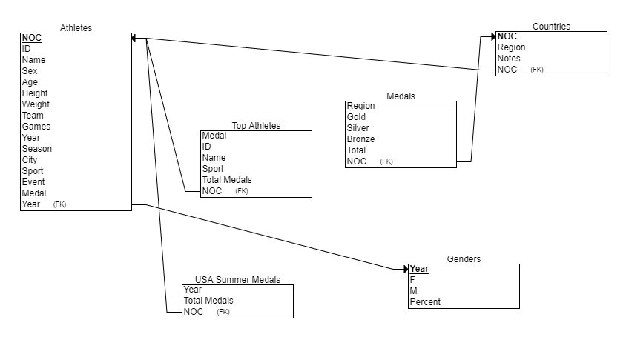
Entity Relationship Diagram (ERD)

